Slide 1
Loss Functions

Slide 2
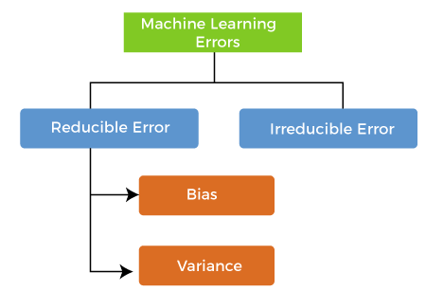

Slide 3
Irreducible errors: These errors will always be present in the model regardless of which algorithm has been used.
The cause of these errors is unknown variables whose value can't be reduced

Slide 4
Cost function and Loss function:
Are they the same thing?

Slide 5
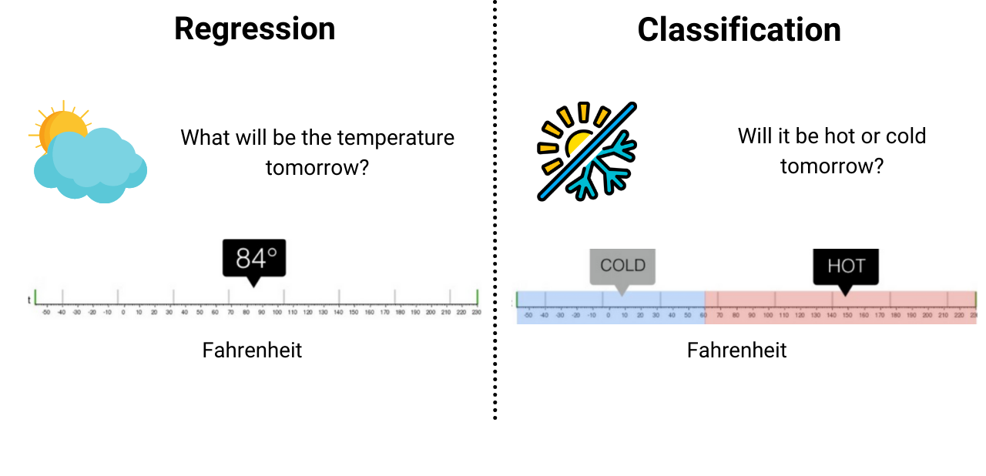
Problem Statements

Slide 6
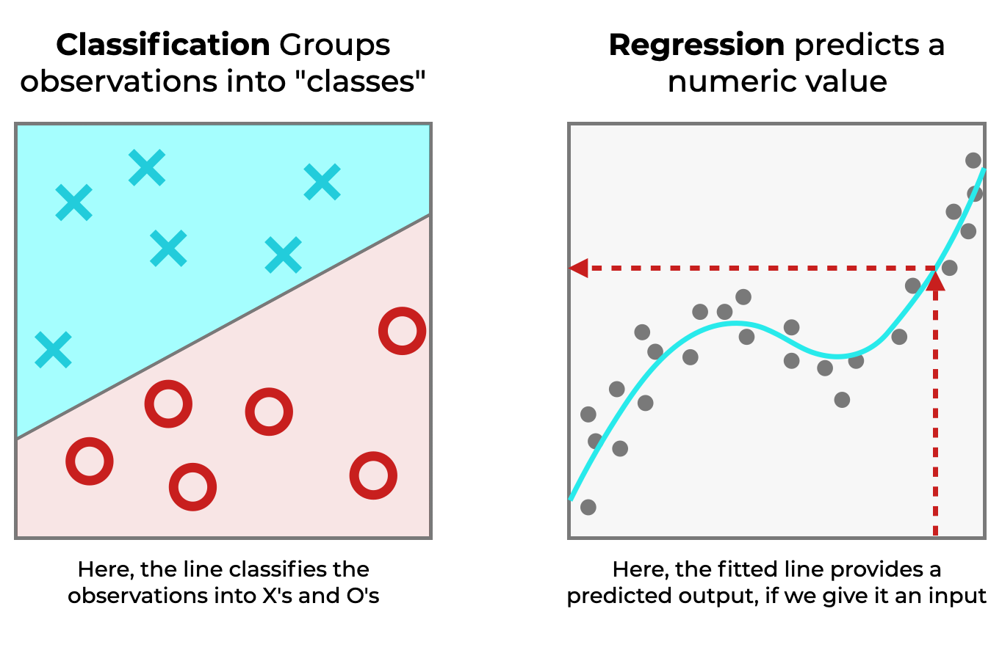

Slide 7
A loss function is used to measure how well a model's prediction matches the actual values.
It's typically used at the individual data point level.
The loss function gives us a value that represents how "bad" or "good" the model's prediction is for a single example.
Loss Function

Slide 8

Loss Function - Mean Squared Error (MSE)

Slide 9
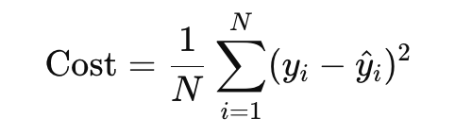
Cost Function
J

Slide 10
A cost function typically refers to the average loss over the entire dataset.
It is used to evaluate the overall performance of the model during training. The goal during training is to minimize the cost function.
The cost function aggregates the losses of all individual examples, often by computing the mean or sum of the losses.
Cost Function

Slide 11
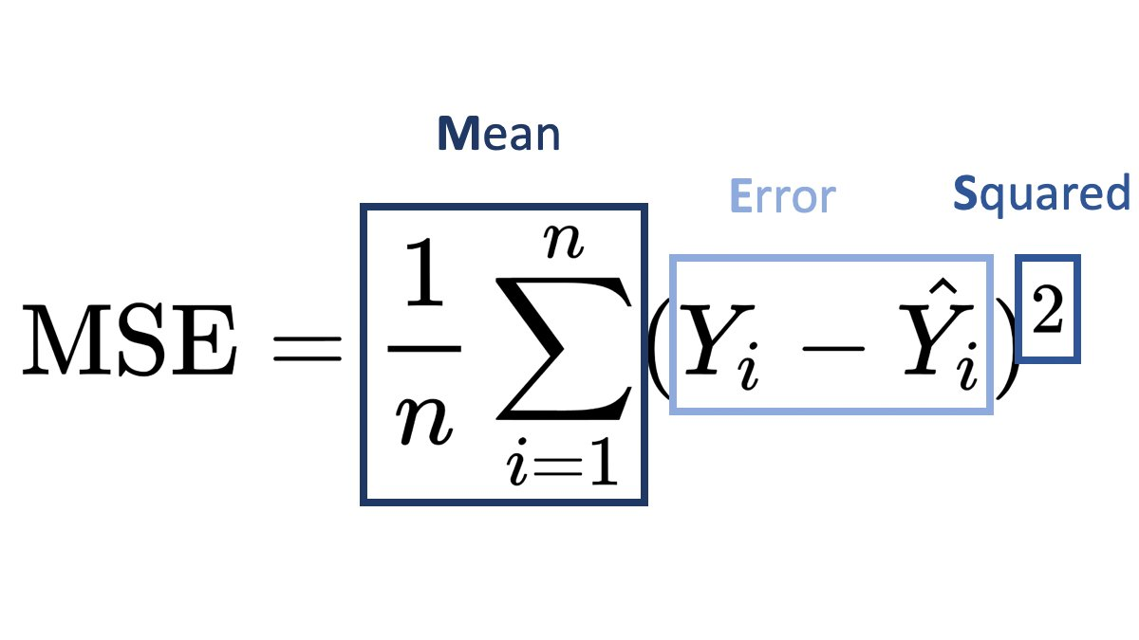
Why use MSE?
Quadratic Equation
Penalizes large errors in the model
Expressed in squared units of the target variable
Differentiable and smooth

Slide 12
Why use MSE?
Quadratic Equation
Penalizes large errors in the model
Expressed in squared units of the target variable
Differentiable and smooth
It's continuous and differentiable - it's easier to find the minimum using techniques like backpropagation in Neural Networks

Slide 13
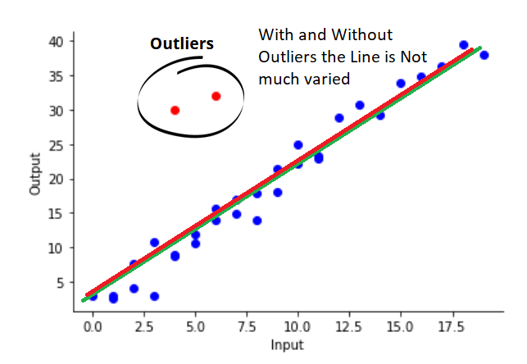
When to avoid MSE?

Slide 14
Mean Absolute Error (MAE) - Treats All Errors Equally

Slide 15
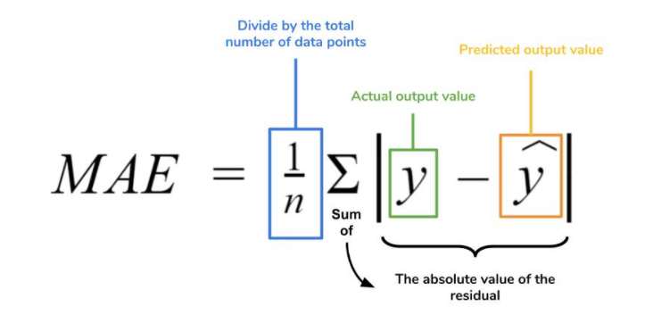

Slide 16
Why use MAE?
More robust to outliers compared to MSE

Slide 17
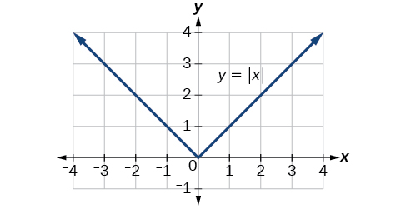
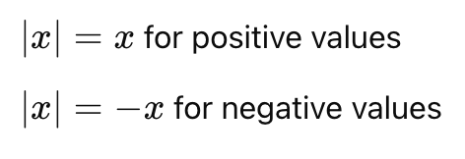
Computationally Difficult

Slide 18
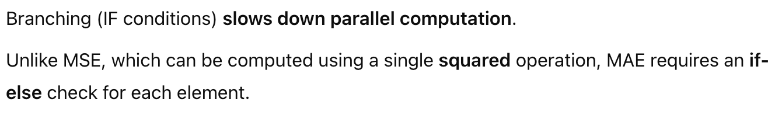
Computationally Difficult

Slide 19
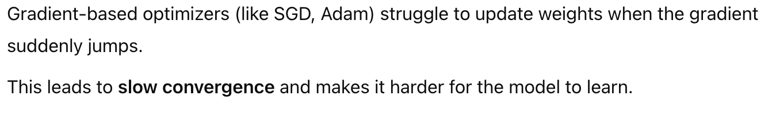
Computationally Difficult

Slide 20
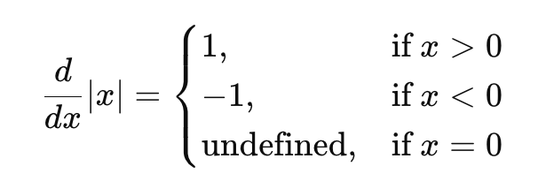
Computationally Difficult

Slide 21
Huber Loss

Slide 22
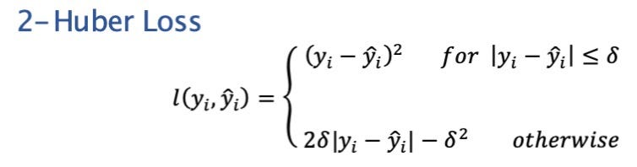
Huber Loss

Slide 23
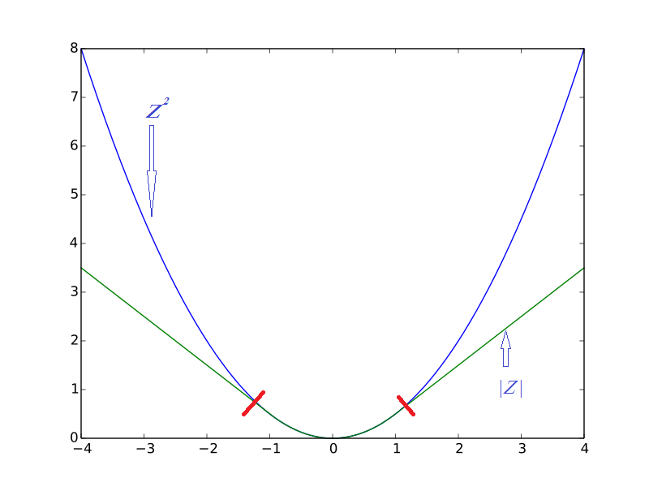

Slide 24
Classification

Slide 25
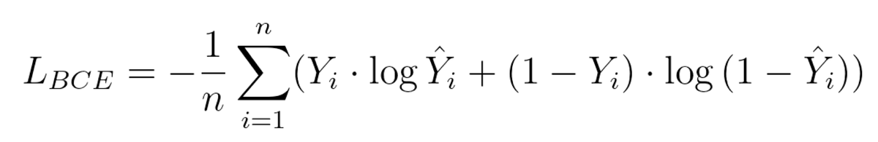
Cross Entropy

Slide 26
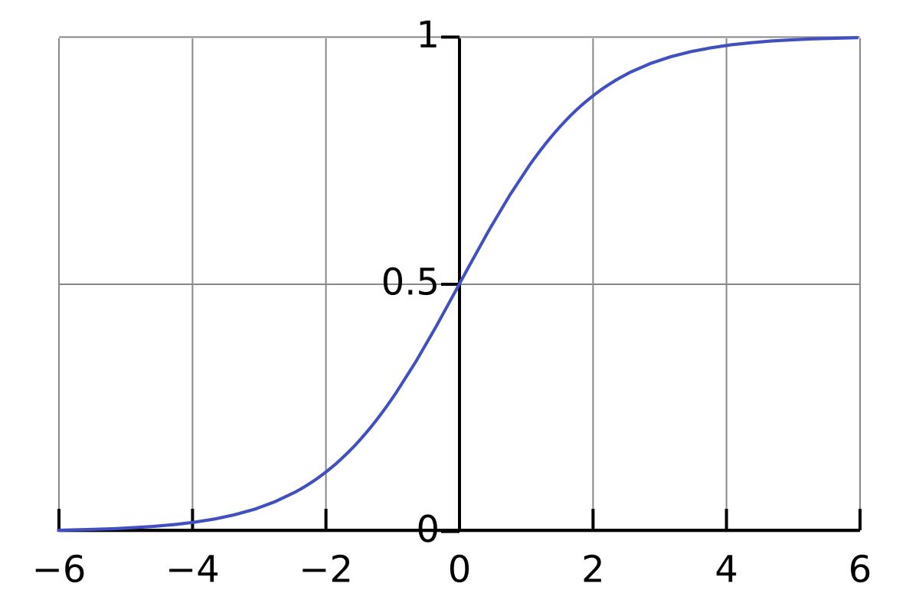


Slide 27

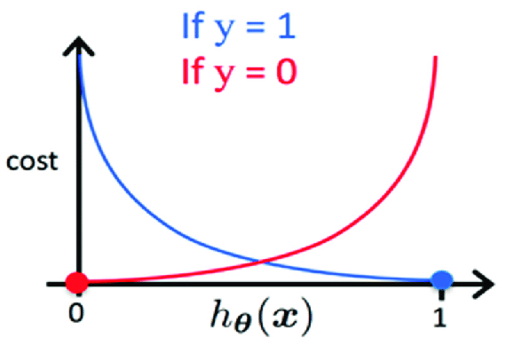


Cross Entropy
If y = 1,
If y = 0,

Slide 28
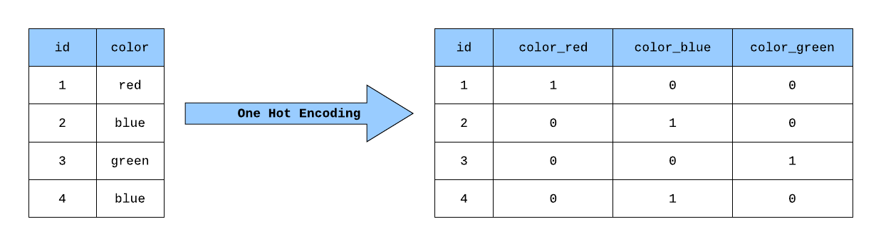
Categorical Cross Entropy

Slide 29
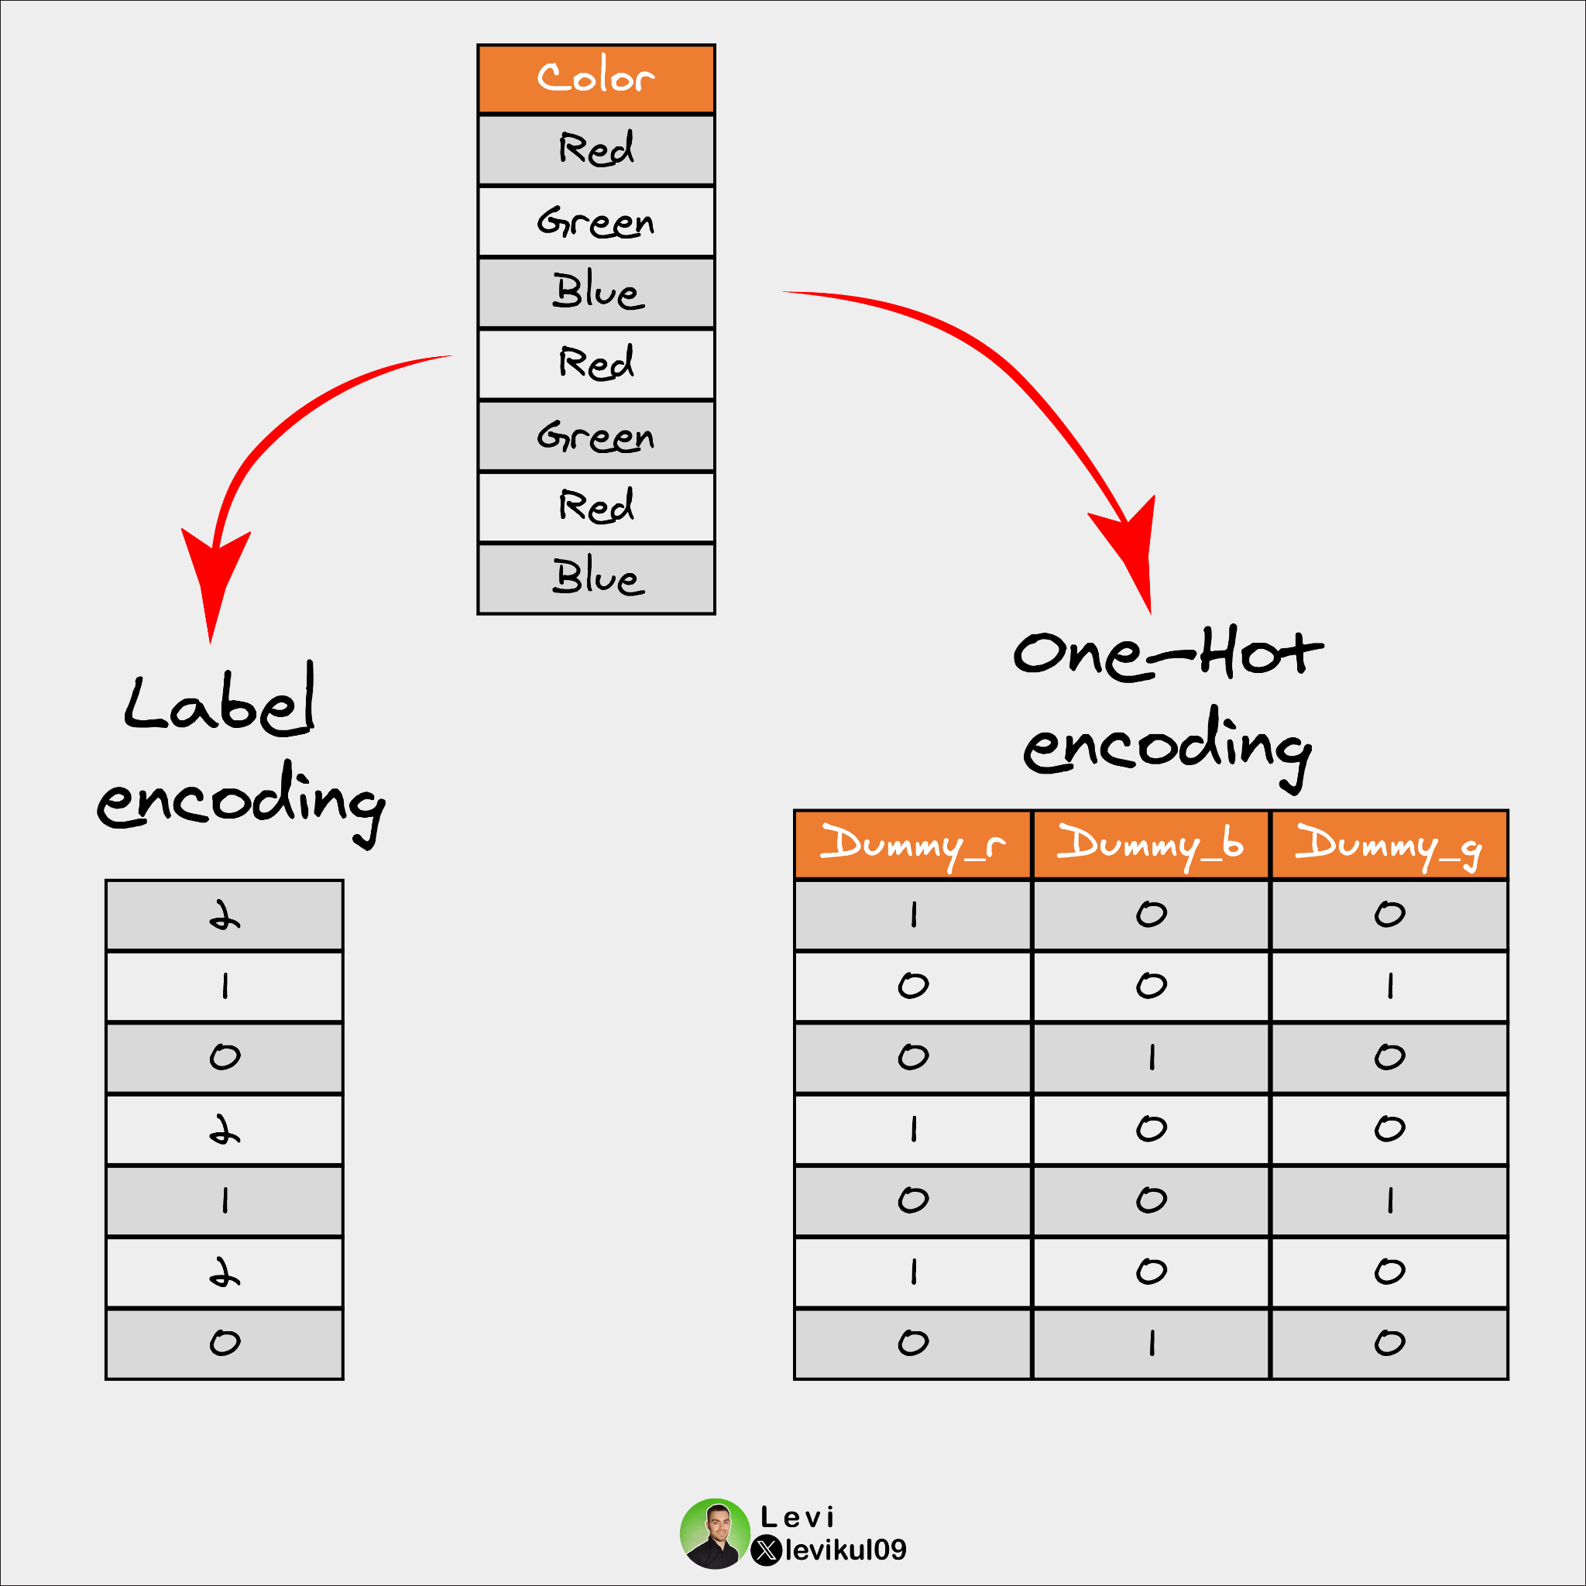

Slide 30

Sample | Class 1 | Class 2 | Class 3 | Class 4
1 | 1 | 0 | 0 | 0
2 | 0 | 1 | 0 | 0
3 | 0 | 0 | 1 | 0

Slide 31
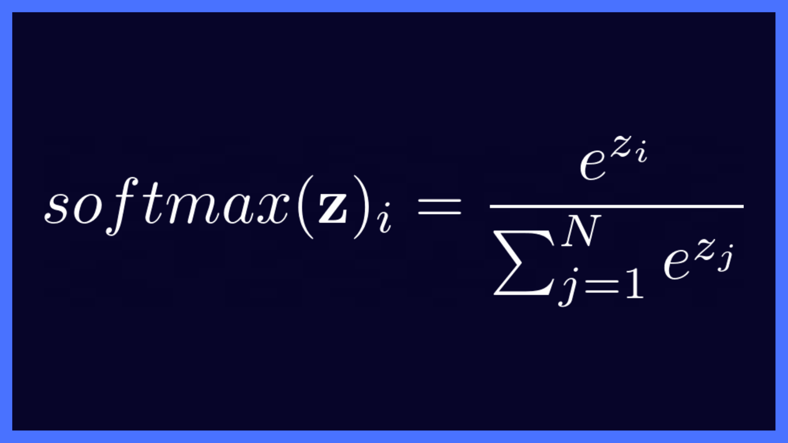

Slide 32
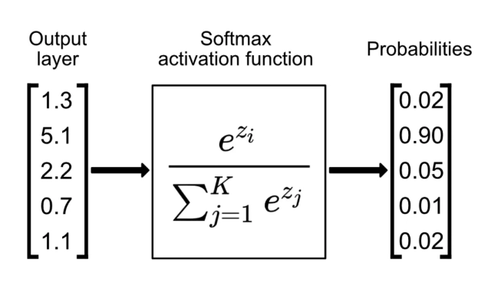

Slide 33





Sample | Class 1 | Class 2 | Class 3 | Class 4
1 | 1 | 0 | 0 | 0
2 | 0 | 1 | 0 | 0
3 | 0 | 0 | 1 | 0
Sample
1 | 0.7 | 0.1 | 0.1 | 0.1
2 | 0.2 | 0.5 | 0.2 | 0.1
3 | 0.1 | 0.1 | 0.6 | 0.2

Slide 34

Sample
1 | 0.7 | 0.1 | 0.1 | 0.1
2 | 0.2 | 0.5 | 0.2 | 0.1
3 | 0.1 | 0.1 | 0.6 | 0.2

Slide 35
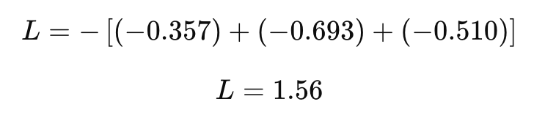

Slide 36
The Bias & Variance Trade-off

Slide 37
What is Bias?
Bias is the error caused by simplifying the model too much.
A model with high bias makes strong assumptions about the data.
It doesn’t learn well from the training data and underfits.

Slide 38
What is Variance?
Variance is the error caused by a model being too complex and sensitive to small changes in data.
A model with high variance learns the noise in the training data instead of the real pattern.
It overfits and performs poorly on unseen data.

Slide 39
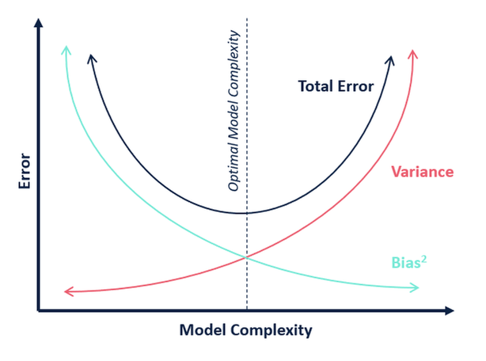

Slide 40
How to Reduce Bias and Variance?
Reducing Bias (Fix Underfitting)
Use a more complex model (e.g., add layers to a neural network).
Train for more epochs (longer training).
Reduce regularization (if using L1/L2 regularization).
Reducing Variance (Fix Overfitting)
Use more training data (helps the model generalize).
Use regularization (L1, L2, Dropout).
Simplify the model (fewer layers, less complexity).

Slide 41
Optimizers

Slide 42
Epoch is the number of times the algorithm iterates over the entire training dataset
Batch refer to the number of samples used for updating the model parameters
A sample is a single record of data in a dataset
Learning Rate is a parameter determining the scale of model weight updates
Weights and Bias are learnable parameters in a model that regulate the signal between two neurons.

Slide 43
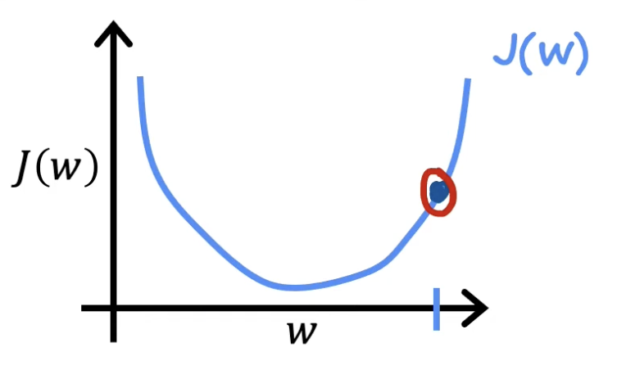
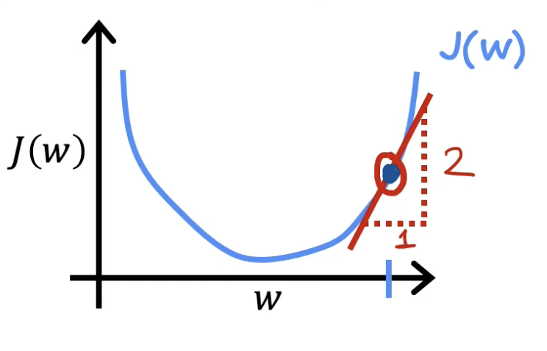
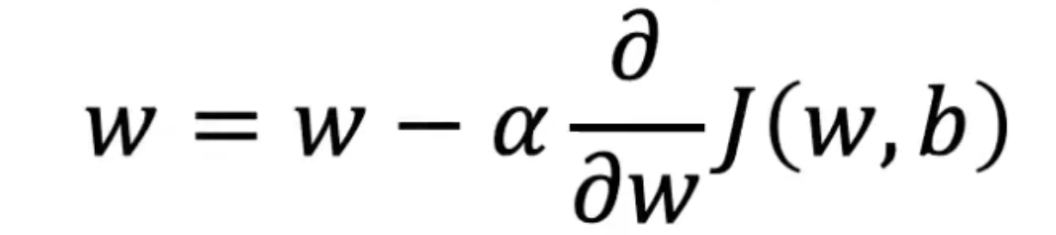
Gradient Descent

Slide 44
In Gradient Descent, a single step is taken by considering the entirety of the training data.
The process involves calculating the average of the gradients for all training examples, and this mean gradient is employed to update the parameters.
This constitutes a singular step in the Gradient Descent process within a single epoch or iteration

Slide 45
A single step is taken by considering the entirety of the training data.
Calculate the average of the gradients for all training examples, and this mean gradient is employed to update the parameters.
This constitutes a singular step in the Gradient Descent process within a single epoch or iteration

Slide 46
Input Feature(x) | Actual Price(y)
500 | 1,50,000
1000 | 2,50,000
1500 | 3,20,000
2000 | 4,50,000
2500 | 5,50,000

Slide 47
Stochastic Gradient Descent (SGD)

Slide 48
In SGD, we compute the gradient using one data point at a time. After processing one data point, we immediately update the model parameters and move to the next data point.

Slide 49
In SGD, we compute the gradient using one data point at a time. After processing one data point, we immediately update the model parameters and move to the next data point.
So, if the dataset contains 10000 rows, SGD will update the model parameters 10000 times in a single cycle through the dataset, as opposed to just once in the case of Gradient Descent.

Slide 50
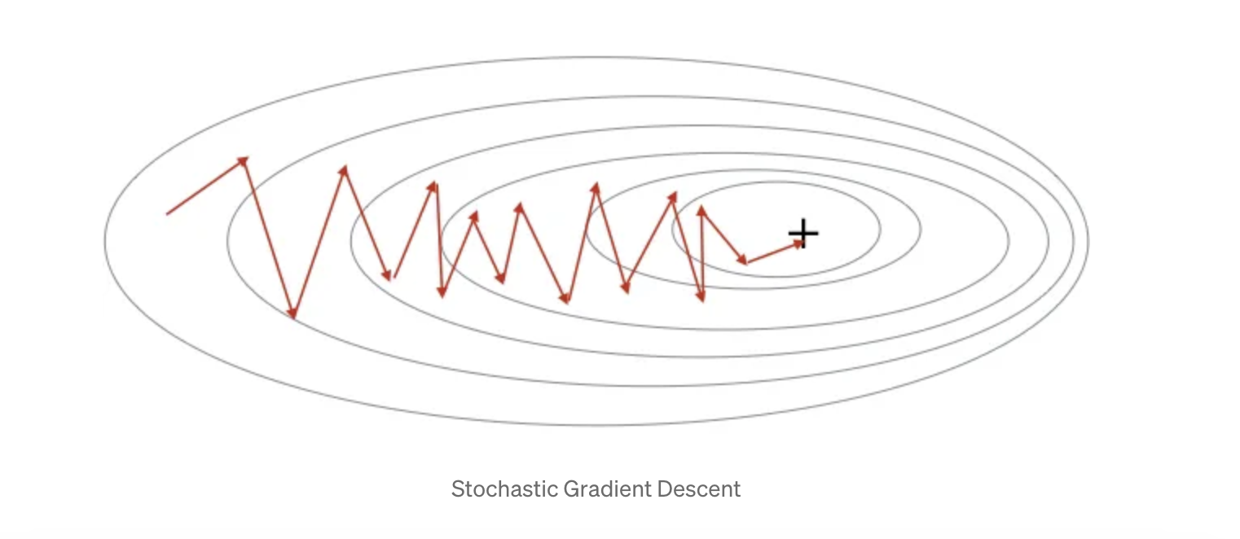

Slide 51
Mini-Batch Gradient Descent

Slide 52
Total Records: 10,000 records (data points)
Batch Size: 100 (i.e., the number of data points per mini-batch)
Epochs: 10 (an epoch means one complete pass through the entire dataset)

Slide 53
Total Records: 10,000 records (data points)
Batch Size: 100 (i.e., the number of data points per mini-batch)
Epochs: 10 (an epoch means one complete pass through the entire dataset)

Slide 54
Total Records: 10,000 records (data points)
Batch Size: 100 (i.e., the number of data points per mini-batch)
Epochs: 10 (an epoch means one complete pass through the entire dataset)

Slide 55
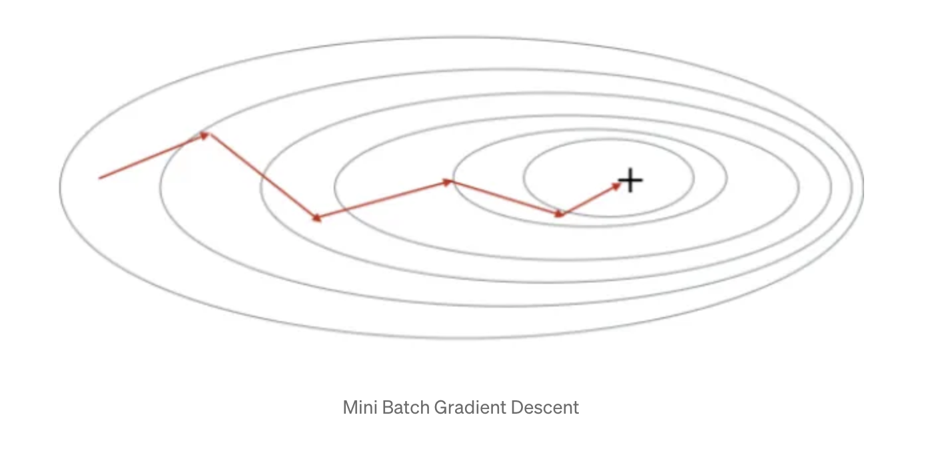

Slide 56
